Slide 1
Cyclistic Case Study: Converting Casual Riders to Annual Members
Author: Moses Oni
May 2025
Photo by Charles Forerunner on Unsplash
Notes:
© Copyright Showeet.com – Creative & Free PowerPoint Templates

Slide 2
Table of Contents
01
04
Executive Summary
Key Insights
Quick overview of goals, data, and outcomes.
Core behavioral differences found in the data.
02
05
Business Task
Recommendations
The question driving the analysis.
Three data-driven ideas to convert casual riders.
03
Data Preparation & Processing
06
Conclusion & Next Steps
How the raw data was cleaned and structured.
Wrap-up, impact, and future opportunities.
Notes:
© Copyright Showeet.com – Creative & Free PowerPoint Templates

Slide 3
Executive Summary
01
Cyclistic wants to increase annual memberships.
I analyzed 5.7M+ rides from Divvy using Python.
Applied Google’s 6-step data analysis process.
Found clear behavioral differences between Members and Casuals.
Designed 3 actionable strategies for conversion.
Notes:
© Copyright Showeet.com – Creative & Free PowerPoint Templates

Slide 4
Ask: Business Question
02
Main Question: How do annual members and casual riders use Cyclistic bikes differently?
Goal: Help Cyclistic convert more casual riders into members with data-backed strategies.
Notes:
© Copyright Showeet.com – Creative & Free PowerPoint Templates

Slide 5
Prepare & Process Data Cleaning
03
12 CSVs data files(January 2023 – December 2023) Combined in Python.
Converted times, calculated ride length
Extracted day of week & hour
Removed bad data.
Focused on “member” and “casual” riders.
Final Dataset: 5.7M+ clean rows
Notes:
© Copyright Showeet.com – Creative & Free PowerPoint Templates

Slide 6
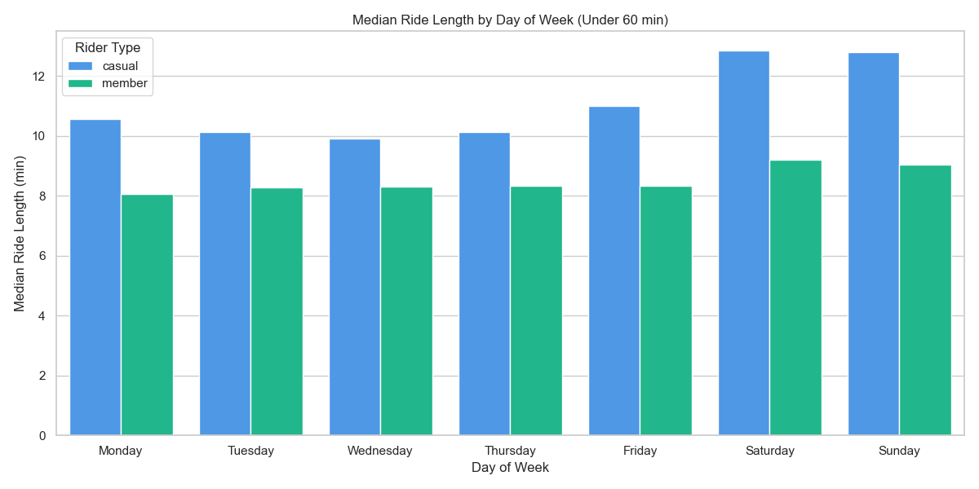
Casuals Ride Longer Than Members
Casual riders: avg. 28.3 min
Members: avg. 12.5 min
Casuals: Ride for leisure
Members: Ride for efficiency
Notes:
© Copyright Showeet.com – Creative & Free PowerPoint Templates

Slide 7
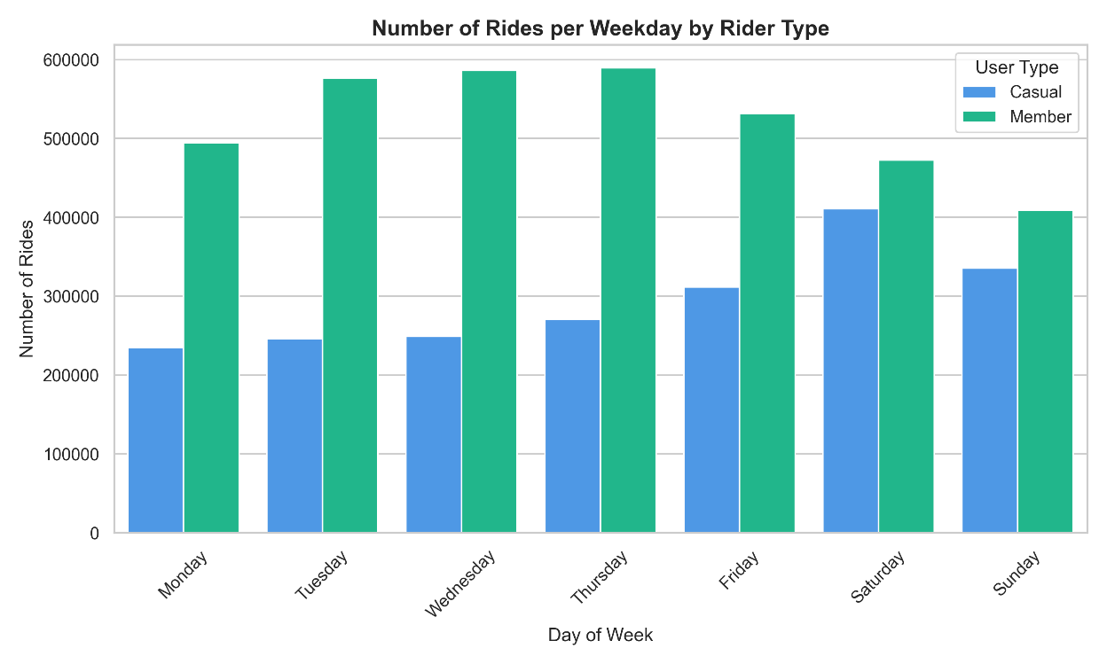
Weekend Warriors vs. Weekday Commuters
Casual riders: peak on weekends, esp. Saturdays
Members: ride most weekdays
Casuals: Ride for Recreation
Members: Ride for commuting
Notes:
© Copyright Showeet.com – Creative & Free PowerPoint Templates

Slide 8
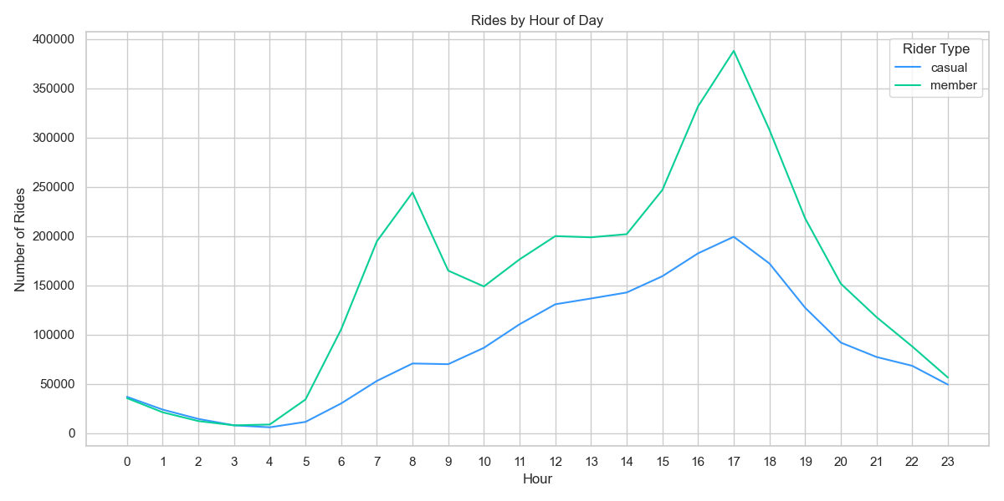
Time of Day
Casual riders: ride midday and evenings
Members: ride during rush hours
Indicates different ride purposes
Notes:
© Copyright Showeet.com – Creative & Free PowerPoint Templates

Slide 9
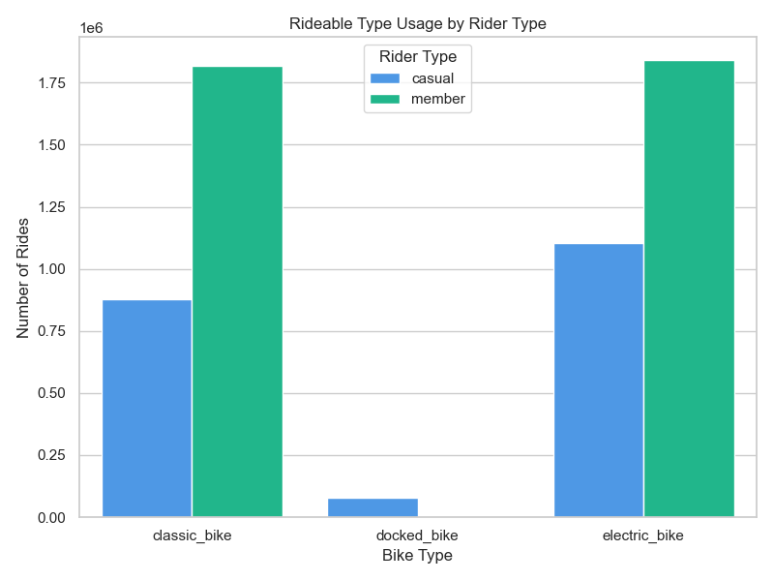
Bike Type Preference
Casual riders: prefer electric & docked bikes
Members: favor classic bikes
Convenience and ease matters more to Casuals
Notes:
© Copyright Showeet.com – Creative & Free PowerPoint Templates

Slide 10
Act: Marketing Recommendations
05
Weekend Explorer Pass
Encourage trial usage through weekend-only deals.
Electric Bike Bonus
Offer free e-bike minutes to attract convenience-seekers.
Weekday Commuter Campaign
Target casual weekday riders with value-driven commuter perks.
Notes:
© Copyright Showeet.com – Creative & Free PowerPoint Templates

Slide 11
Framework Applied
06
Ask → Define the challenge
Prepare → Collect data
Process → Clean & prep
Analyze → Extract patterns
Share → Visual + narrative
Act → Recommend strategy
Notes:
© Copyright Showeet.com – Creative & Free PowerPoint Templates

Slide 12
Act: Marketing Recommendations
05
Weekend Explorer Pass
Encourage trial usage through weekend-only deals.
Electric Bike Bonus
Offer free e-bike minutes to attract convenience-seekers.
Weekday Commuter Campaign
Target casual weekday riders with value-driven commuter perks.
Notes:
© Copyright Showeet.com – Creative & Free PowerPoint Templates

Slide 13
In data , we don't just find answers; we uncover the stories waiting to be told.
-- Moses Oni & Chat GPT --
Notes:
© Copyright Showeet.com – Creative & Free PowerPoint Templates

Slide 14
Conclusion & Contact
Demonstrated how data drives strategic decisions.
First full analysis project shared publicly.
Open to collaboration, feedback, and opportunities.
Contact:
GitHub Link: Cyclistic-Case-Study
LinkedIn Link: Moses Oni
Gmail Address: oni.moses01@gmail.com
Notes:
© Copyright Showeet.com – Creative & Free PowerPoint Templates

Slide 15

Thank You!
Do you have any questions?
Notes:
© Copyright Showeet.com – Creative & Free PowerPoint Templates

